Slide 1
Database Connectivity through ADO.NET
Unit V

Slide 2
Contents
Evolution of ADO.NET
Understanding the ADO.NET Object Model
Connected vs. Disconnected Access
Use of Connection
Command Class
DataReader Class
DataAdapter and Dataset class.

Slide 3
Why should we use database with applications?
Can we make applications work without database?
How an application works with database?

Slide 4
How your application connects with the database?
SQL .NET
Data Provider
SQL SERVER
OLE DB .NET
Data Provider
OLE DB
Provider
Other DB
ODBC .NET
Data Provider
ODBC
Driver
Other DB

Slide 5
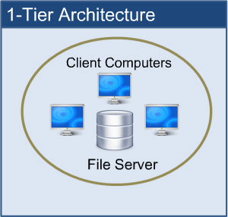
Database Architecture
1 – tier architecture
One-tier architecture involves putting all of the required components for a software application or technology on a single server or platform.

Slide 6
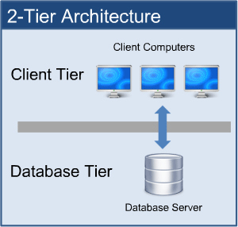
Database Architecture
2 – tier architecture
The two-tier architecture is like client server application. The direct communication takes place between client and server. There is no intermediate between client and server.

Slide 7
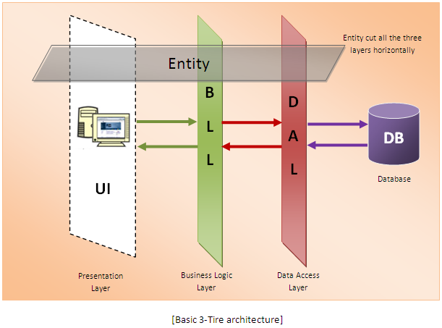
Database Architecture
3 – tier architecture
A 3-tier architecture separates its tiers from each other based on the complexity of the users and how they use the data present in the database. It is the most widely used architecture to design a DBMS.

Slide 8
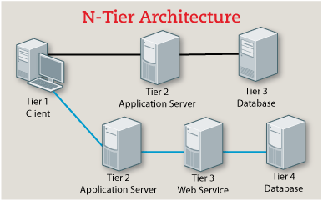
Database Architecture
n – tier architecture
N-tier architecture would involve dividing an application into three different tiers. These would be the
logic tier,
the presentation tier, and
the data tier.

Slide 9
Evolution of ADO.NET
In the beginning there was file based storage. All data of applications was stored in file. 0 – tire.
Then came DBMS systems. But still the application and data was stored in the same machine. 1 – tire.
After some evolution in DBMS technology and network technology, the DBMS system was separated from the application. Now application and database were present on two different machines connected with a network connection. 2 – tire.
In this time ADO (Active-X Data Object) was introduced – A Microsoft technology used for connecting applications with database.
This technology is still in use by old applications.

Slide 10
Evolution of ADO.NET
However, there are many limitations of this technology.
Only client server architecture is supported.
It is connected oriented.
No resource optimization.
No support for OOP.
No XML support.
Only sequential data access.
And many more..
ADO.NET was introduced with .NET framework 1.0 to overcome all the problems of ADO.

Slide 11
Understanding the ADO.NET Object Model
ADO.NET is a library – A collection of classes that contains various functions and properties that are useful when working with database through an application.

Slide 12
Understanding the ADO.NET Object Model
DataAdapter
Fill
DataSet
Update
Errors Collection
SelectCommand
UpdateCommand
InsertCommand
DeleteCommand
Command
Connection
Parameters
Data Source

Slide 13
Connected vs. Disconnected Access
A connection to database is created to access data from the database.
Older applications developed using connected model for data access used to keep the database connection active as long as the application is running.
Keeping a database connection alive, is costly in terms of memory resource.
This is done with a special object called “DataAdapter”.
So if a database server has memory to store data of 100 connection and all memory is full, then it becomes unable to access 101st connection, even when out of 100 active connections only 10 are actively interacting with the database server.
Here comes the disconnected in the picture.

Slide 14
Connected vs. Disconnected Access
A disconnected access uses connection for short period of time.
The connection is made with the database server only to download the data from the server once the data is downloaded in the local memory the connection is closed.
The data once fetched from the server is stored in a special object on client side in offline manner. The client application uses this special object to access the data.
This special object is called a DATASET.
The programmers can not only read data from the dataset but can also write new data, update existing data and delete data in the dataset.
The connection is also made when there is an update in data on client side that needs to be reflected in the server.
This technique results in less parallel connection to the database server and one server can serve more clients.

Slide 15
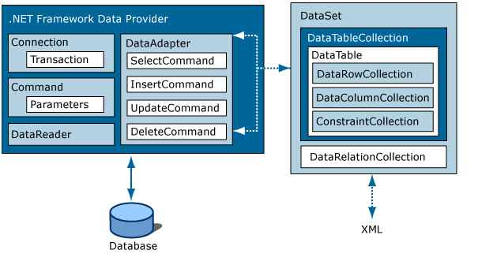
Connected vs. Disconnected Access

Slide 16
Connected vs. Disconnected Access
Connected | Disconnected
To read data it uses Datareader object | To read data it uses DataSet
Uses DataAdapter to change and delete the data | Uses combination of Dataset and DataAdapter to change and delete the data.
Connected methods gives faster performance | Disconnected get low in speed and performance
Can hold the data of single table only | disconnected can hold multiple tables of data
you need to use a read-only forward-only object DataReader | You can access dataset in non-sequential manner.
DataReader can't persist the data | Data Set can persist the data

Slide 17
Namespaces associated with ADO.NET
System.Data
System.Data.Common
System.Data.SqlClient
System.Data.OleDB
System.Data.SqlTypes
System.XML
System.XML.Schema

Slide 18
Using Namespaces
using System.Data; using System.Data.SqlClient;

Slide 19
Connection class
Using sqlconnection class
SqlConnection connection = new SqlConnection(connectionString);
Connection.Open();
//Logic
Connection.Close();

Slide 20
Objects under: System.Data.SqlClient
SqlConnection
SqlCommand
SqlDataReader
SqlDataAdapter
SqlParameter
SqlParameterCollection
SqlError
SqlErrorCollection
SqlException
SqlTransaction
SqlDbType

Slide 21
Connection class
There are more than one connection classes available in ADO.NET.
Depending on what database you want to connect by your application, the namespace of connection class will change.
Here, we will focus on connecting with Microsoft SQL Server DBMS.
Therefore we will use System.Data.SQLClient namespace.
Hence, we will use SQLConnection class.
The object of this class is used to establish connection between your application and the Microsoft SQL Server database.

Slide 22
Command Class
The command class belongs to : System.Data.SqlClient
This class is used to execute various SQL statements including stored procedures against the database.
This class is mostly used with data reader.
Initializing the command class:
Some important methods:
ExecuteReader: Used with “select” queries. Gives datareader type of object in return with resultant rows.
ExecuteNonQuery: Used with “Insert”, “Delete”, “Update” and “Set” queries. Returns integer value 0 or 1 to determine success or failure of the query.
ExecuteScalar: Used with “Select” queries that return “Single” value or aggregated value.
SqlCommand command = new SqlCommand(query, connection);

Slide 23
DataAdapter Class
This class belongs to namespace: System.Data.SqlClient
This class is used to fill dataset object as a result of a select query and update the database based on changes made in the dataset.
To use the class:
The SqlDataAdapter, serves as a bridge between a DataSet and SQL Server for retrieving and saving data. The SqlDataAdapter provides this bridge by mapping Fill, which changes the data in the DataSet to match the data in the data source, and Update, which changes the data in the data source to match the data in the DataSet, using the appropriate Transact-SQL statements against the data source.
SqlDataAdapter adapter = new SqlDataAdapter(query, connection); adapter.fill(dataset)

Slide 24
DataAdapter Class
Important Methods:
Fill(DataSet): Adds or refreshes rows in the DataSet.
Fill(DataSet, String): Adds or refreshes rows in the DataSet to match those in the data source using the DataSet and DataTable names.

Slide 25
Datareader Class
This class belongs to: System.Data.SqlClient
This class is used to store resultant rows returned by executing a “Select” query on a database.
Datareader provides a read only, forward only object to store and access the rows.
How to use this class:
SqlDataReader reader = command.ExecuteReader();
while (reader.Read())
{
ReadSingleRow((IDataRecord)reader);
}
// Call Close when done reading.
reader.Close();

Slide 26
Datareader Class
To create a SqlDataReader, you must call the ExecuteReader method of the SqlCommand object, instead of directly using a constructor.
While the SqlDataReader is being used, the associated SqlConnection is busy serving the SqlDataReader, and no other operations can be performed on the SqlConnection other than closing it.
This is the case until the Close method of the SqlDataReader is called.
Important Properties:
HasRows: Gets a value that indicates whether the SqlDataReader contains one or more rows.
IsClosed: Retrieves a Boolean value that indicates whether the specified SqlDataReader instance has been closed.
Item[Int32]: Gets the value of the specified column in its native format given the column ordinal.
Item[String]: Gets the value of the specified column in its native format given the column name.

Slide 27
Datareader Class
Important Methods
Close() - Closes the DbDataReader object.
Read() - Advances the SqlDataReader to the next record.

Slide 28
Dataset Class
This class belongs to namespace: System.Data
This class serves as representation of the resultant data in the database at the time of execution of the query for the application.
This class is used in conjunction with dataAdapter class.
How to use this class:
The DataSet consists of a collection of DataTable objects that you can relate to each other with DataRelation objects. You can also enforce data integrity in the DataSet by using the UniqueConstraint and ForeignKeyConstraint objects.
DataSet dataSet = new DataSet();
adapter.Fill(dataSet);

Slide 29
Dataset Class
How to access data from dataset:
A dataset object can hold multiple tables, so tables[0] will refer to the first table. You can access other tables with appropriate index or tables[“student”] by giving name of table in string format.
To access the data in table you can use Rows property with appropriate index values. The first index of rows refers to row and second refers to column of that row.
Hence, row[0][0] will refer to first column of first row. To access next column of first row you have to use row[0][1] and to access next record and its first column you have to used row[1][0].
Dataset ds = new Dataset();
Adapter.Fill(ds);
Ds.Tables[index].Rows[index][index] /Index will start from 0

Slide 30
Dataset Vs. DataReader
DataSet | DataReader
The DataSet is a in-memory representation of data. | The ADO.NET DataReader is used to retrieve read-only (cannot update data back to a datasource) and forward-only (cannot read backward/random) data from a database.
It can be used with multiple data sources. That is A single DataSet can hold the data from different data sources holdng data from different databases/tables. | Using of a DataReader increases application performance and reduces system overheads. This is due to one row at a time is stored in memory.
The DataSet represents a complete set of data including related tables, constraints, and relationships among the tables. | You create a DataReader by calling Command.ExecuteReader after creating an instance of the Command object.
The DataSet can also persist and reload its contents as XML and its schema as XML Schema definition language (XSD) schema. | This is a connected architecture: The data is available as long as the connection with database exists.
The DataAdapter acts as a bridge between a DataSet and a data source for retrieving and saving data. | You need to open and close the connecton manually in code.

Slide 31
Dataset Vs. DataReader
DataSet | DataReader
The DataAdapter helps mapping the data in the DataSet to match the data in the data source.
Also, Upon an update of dataset, it allows changing the data in the data source to match the data in the DataSet.
No need to manually open and close connection in code.

